Slide 1
WELCOME SYLVAN HILLS MIDDLE GO TEAM MEETING

Slide 2
Let’s commit to:
Wearing masks and socially distancing
Being present and engaging meaningfully so that we can learn from each other (i.e. Cameras on)
Refrain from using electronic devices unless required to engage in the work
Muting your microphone (VIRTUAL) and minimizing extraneous conversations
Assuming good will
Allowing all voices of the team to be heard
Focusing on the day’s content
Starting and ending on time
Being gracious

Slide 3
Today’s Agenda
Approval of Agenda
Fill Open Community Seat (TBD)
Approval of Previous Minutes
Set Next GO Team Meeting Date
Review and Approve Public Comment Format
Review, Confirm/Update, and Adopt GO Team Norms
Return + Learn Plan
Principal’s Report
.
Action Itms

Slide 4
GO TEAM MEMBERS 20-21
NAME | ROLE
Ms. Monica Blasingame | Principal
Ms. Jessica Bracey | Parent
Ms. Queen Rosa Harden-Green | Parent
Ms. Sade Miller | Staff
Mr. Derwin Purnell | Staff
Ms. Sonyjia Bryant | Staff
VACANT | Community Member
VACANT | Community Member
Ms. Johna Rhooms | Swing Seat

Slide 5
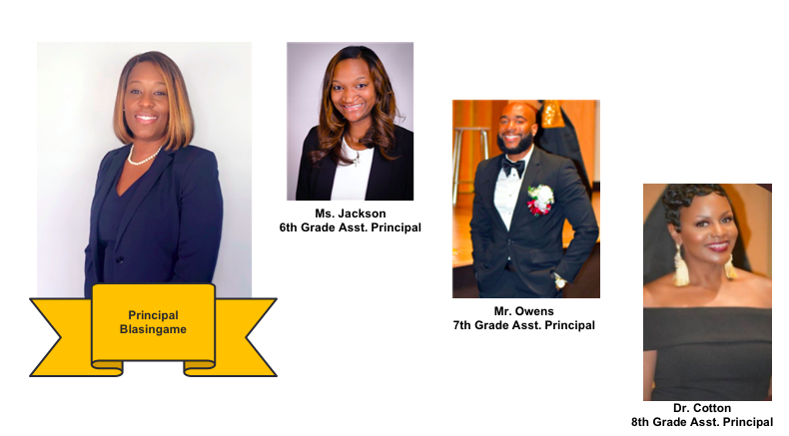
Meet the Admin Team

Slide 6
Action Items
Approval of Agenda
Fill Open Community Seat (TBD)
Approval of Previous Minutes
Set Next GO Team Meeting Date
Review and Approve Public Comment Format
Review, Confirm/Update, and Adopt GO Team Norms
.
Action Itms

Slide 7
Next Go Team Meeting…
DATE?
TIME?

Slide 8
Public Comment [DRAFT]
Sylvan Hills Middle School's GO Team welcomes input from students, staff, parents and community members during designated meetings. This includes an opportunity for public comment at the end of the meeting not to exceed 20 minutes. To register for an opportunity to speak, please adhere to the following:
1. Register at the sign-up table (google form will be available for virtual meetings) no later than 30 minutes prior to the Go Team meeting dates.
2. Please include your name, email address, and topic.
3. Community members signing up to speak will be given two (2) minutes.
4. The Go Team cannot take public comment on personnel issues.

Slide 9
Let’s commit to:
Wearing masks and socially distancing
Being present and engaging meaningfully so that we can learn from each other (i.e. Cameras on)
Refrain from using electronic devices unless required to engage in the work
Muting your microphone (VIRTUAL) and minimizing extraneous conversations
Assuming good will
Allowing all voices of the team to be heard
Focusing on the day’s content
Starting and ending on time
Being gracious

Slide 10
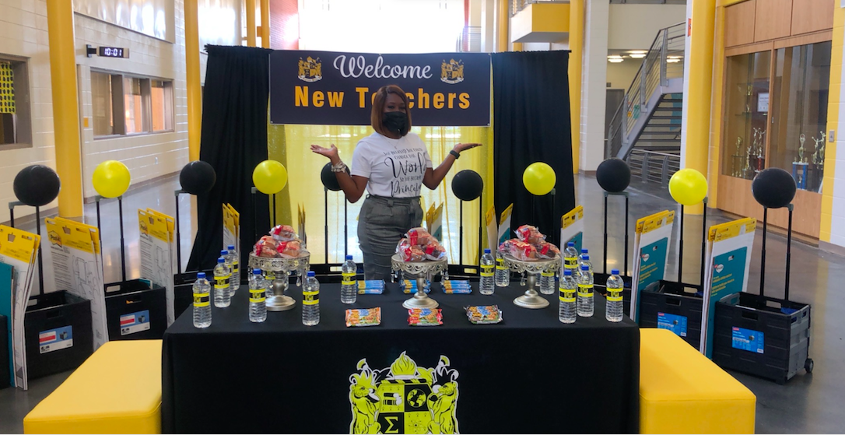
PRINCIPAL’S REPORT
New Golden Bears
School Priorities
Engagement
Enrollment
Budget
Achievement Data
Return to Learn 20-21

Slide 11
New Golden Bears to the Den!
New Golden Bears to the Den!
Ms. Mahoganey Jackson, Assistant Principal
Ms. Kimberly Miles, Counselor
Ms. McKenzie Tooke, 8th Grade IRR ELA
Mr. Samuel Bennett, 8th Grade IRR Math
Ms. Kierra Thompson, 7th Grade ELA
Ms. Tiana Smith, 7th Reading Intervention
Ms. Diamond Leben, 6th Grade IRR Sci./ Soc. Studies
Ms. Jessica Smith, 6th Grade IRR ELA
Ms. Brianna Robison, 6th Grade Soc. Studies
Ms. Ashlie Hansberry, 6th Grade ELA
Ms. Valerie Davis- Missick, Chorus

Slide 12
Sylvan Hills Middle (Carver Cluster)
District Mission & Vision
Cluster Mission & Vision
School Mission & Vision
With a caring culture of trust and collaboration, every student will graduate ready for
college and career.
A high-performing school district where students love to learn, educators inspire, families engage and the community trusts the system
Through a culture of collaboration, respect, and trust, the Carver Cluster will enhance and strengthen its overall academic programs while maintaining a sage and nurturing environment that prepares students for college and careers.
The Carver Cluster will produce high-performing, college and career ready students that are globally aware and ready to have a positive impact on society.
It is our mission to provide a learning environment that ensures high expectations for all of our scholars through quality instruction, real-world applications and technology that promotes and fosters knowledge and skills.
Sylvan Hills Middle School will provide a nurturing and safe environment where scholars become critical thinkers, problem solvers, lifelong learners, and productive citizens.
Signature Program: College And Career Prep
School Priorities
School Strategies
Key Performance
Measures
Cultivate a literate community in which students read and write with clarity and fluency across all contents
Improve students’ mathematics performance
Improve students’ enrollment and success in higher-level classes
1A. Develop, implement and monitor best writing practices across all contents. 1B.Implement a meaningful literacy/math block (SFA) that includes whole group instruction, flexible small group instruction and literacy work stations.
1C. Develop and implement a Response to Intervention (RTI) plan, beginning with strong first teaching and targeted intervention.
1D. Implement Definitions of Teaching Excellence
2A-E. Same as 1B-1F
2F. Implement weekly common assessments
2G. Focus on unit assessment performance
3A. Develop master schedule aligned with student data, needs, and high school course offerings
3B. Offer more courses that will earn high school credits
Increase students performance on GA Milestones in Reading, Writing, and Math.
Increase student performance on STAR Assessment.
Increase students performance on 4sight reading assessment (quarterly).
Improve performance on district benchmark assessment
Improve NAEP scores (8th grade only)
Increase the number of parents and community members that participate in local and state administered surveys.
Increase TKES evaluation scores
Increase overall CCRPI rating
Improve students’ attendance
Improve culture and climate ratings
Academic
Program
Foster a culture of ongoing support for teacher development.
Recruit and maintain highly talented faculty/staff trained in researched-based best for developing the total middle school student (academically, socially, and emotionally)
4A. Identify teacher growth opportunities to provide ongoing coaching support.
Communicate clear expectations and feedback to teachers.
4B. Consistently implement revised teacher induction program for staff new to Sylvan.
4C. Provide ongoing valuable staff development designed to help staff elevate the rigor in the classroom and help students utilize higher order thinking, reading and writing skills.
5A. Establish and maintain incentive program to reward faculty and staff who consistently demonstrate the highest standards of professionalism.
Talent
Management
Engage all facets of the community as partners and align people and resource to maximize impact.
6A. Build relationships between school leadership/staff and partner leadership in order to better serve the needs of the Sylvan Hills community.
6B. Strengthen family and community support to increase parent involvement.
6C. Establish and maintain communication with the community about formal and diverse engagement opportunities at Sylvan Hills.
6D. Offer ongoing surveys to students, staff, and parents to determine needs and current awareness of existing programs and community resources.
Systems &
Resources
Provide increased teaching and learning opportunities for all staff and students.
7A. Implement Social Emotional Learning (SEL) daily.
7B. Utilize the services of the Northstar Psychological Services and other providers to assist students/families.
7C. Create a culture to support and encourage our students to behave in a positive manner where they all can learn and feel protected in a safe and orderly environment
Culture

Slide 14
SCHOOL PRIORITIES
2020-2021 SCHOOL PRIORITIES

Slide 15
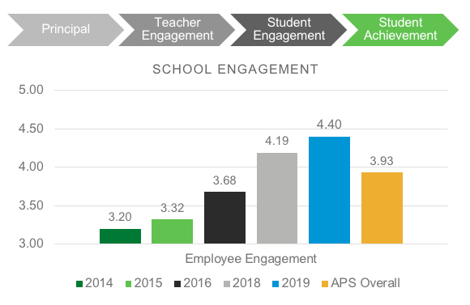
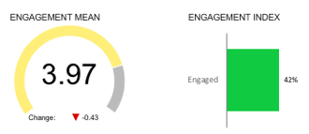
Engagement Staff (as measured by the Q12 Staff Engagement Survey)
2020
33%
62%
69%

Slide 16
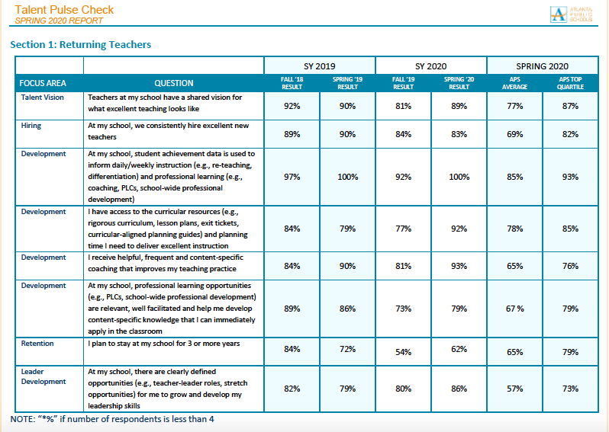

Slide 17
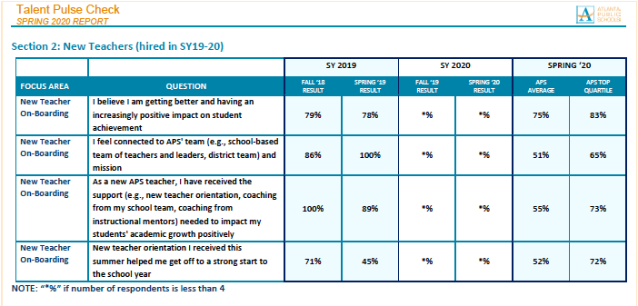

Slide 19
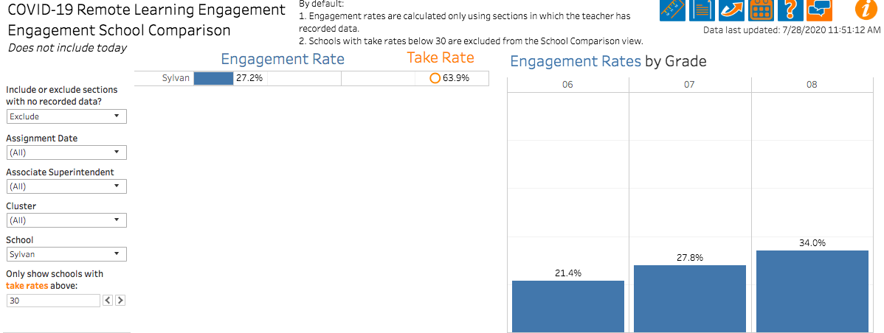
Student Engagement (as determined by the APS GRAPHS Dashboards)

Slide 20
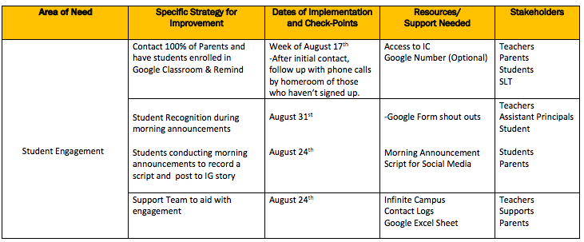
ACTION PLAN

Slide 21
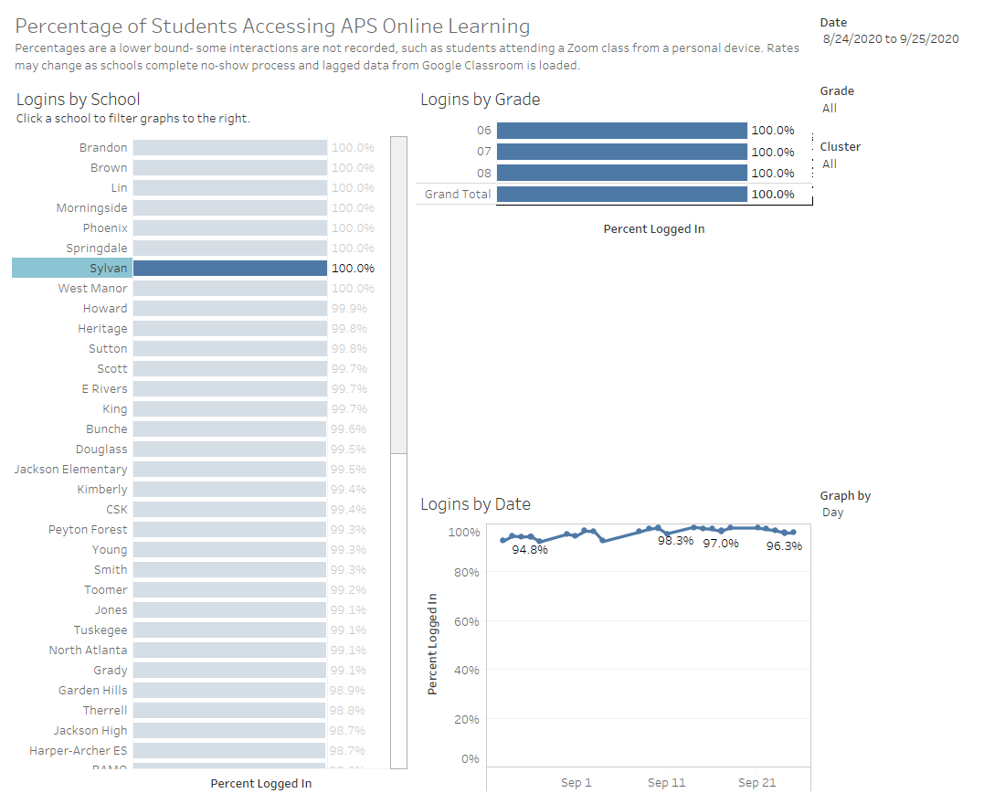

Slide 22
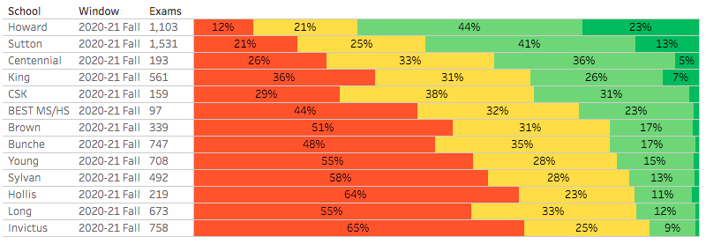
STAR READING – FALL 2020

Slide 23
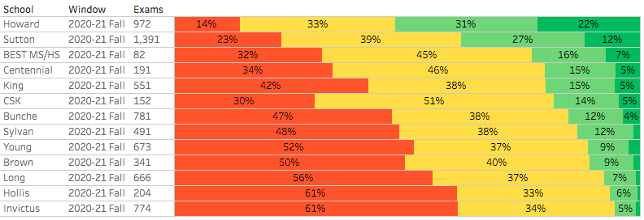
STAR MATH – FALL 2020

Slide 24
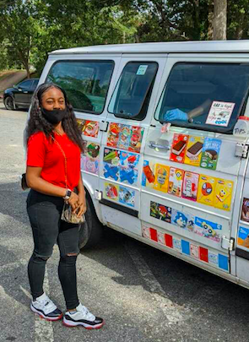
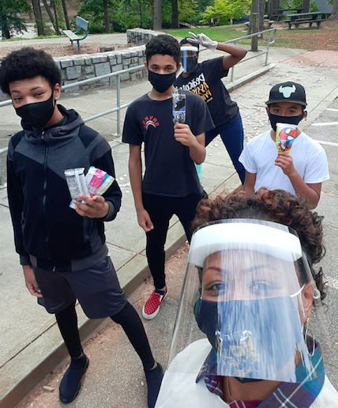
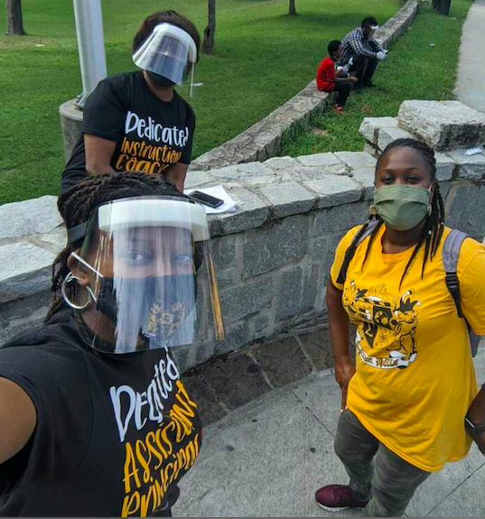
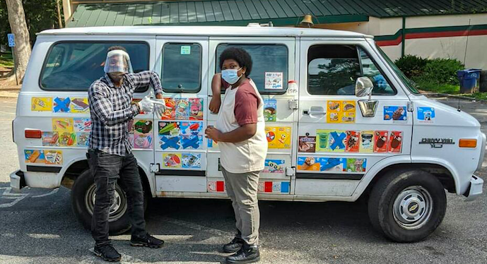
PROUD MOMENTS
Engagement Data / Celebrations
Verizon Innovation Learning Grant

Slide 25
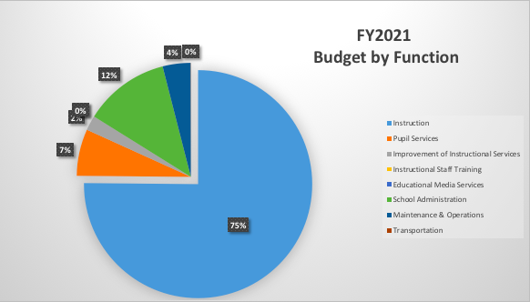
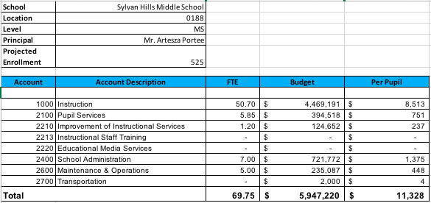
SHMS Budget

Slide 26
The projected enrollment for Sylvan Hills Middle was 525 students. As of the 15th day of school (September 14, 2020), Infinite Campus reflected the actual enrollment for Sylvan Hills Middle was 542 students. Since Sylvan Hills Middle was over projected enrollment by 17 students, an increase of $75,429 would be required (at the SSF base per pupil amount of $4,437) IF we were to make adjustments based on this data.

Slide 27
SYLVAN HILLS
BUDGET
What does that mean?
Projected Enrollment | 525 students
Allocation | $5,906,830
Leveling | $ 75,429
iReady | $ 5,000
Success For All | $ 5,600
Materials & Supplies | $64,829
TBD
Net Adjustment | $ 0

Slide 28
Return to Learn 2020-2021
Questions you may have…
When we will return?
Will parents be given choice?
How will school operate?
Find Up-To-Date information at:
Return-To-Learn
https://www.atlantapublicschools.us/Page/64742

Slide 29
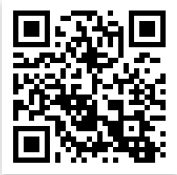
Connect with US!
@apssylvanhillsms
https://www.atlantapublicschools.us/Page/4020
@apssylvanhills

Slide 30
Questions?
Feedback?
Concerns?

